Slide 1

Bitcoin
Show me the Money????

Slide 2
Outline
Jing & Carlos: Tweeter / Sentiment Analysis
Can we use tweeter to identify sentiment movements about Bitcoin which could lead us to act (research more, sell or buy)?
Carlos: We listened twitter for a couple of hours, and we got a good representation of the world. Bitcoin is a worldwide topic.
Jing – First we needed to establish what is normal level of sentiment. Thus, we read tweets for approximately two hours to establish baseline..
Normal Positive: 30 to 35%;
Normal Negative: 8 to 12%
Carlos: Now we wanted to create a tool to measure sentiment NOW? Thus, as you follow Bitcoin, and you see sentiment moving outside of the normal, it could be a flag for doing more research, buying or selling
Pie vs. Trend line
Finally, you could see the actual tweets (positive, negative or neutral)
Kent:
Davis:
What are we doing: Why study bitcoin?
Personal story Davis/Alex trade bitcoin
Bitcoin’s tremendous growth <-> social media / mainstream adoption
Bitcion is inherntly digital, It is almost entirely speculative due to its nonphysical nature (magic internet money)
Billion dollar pizza?
Show comparison to other commodities
Alex:
Explain how it works (brief)
Zoom in on a section, anecdote
Density trends, article content trends

Slide 3
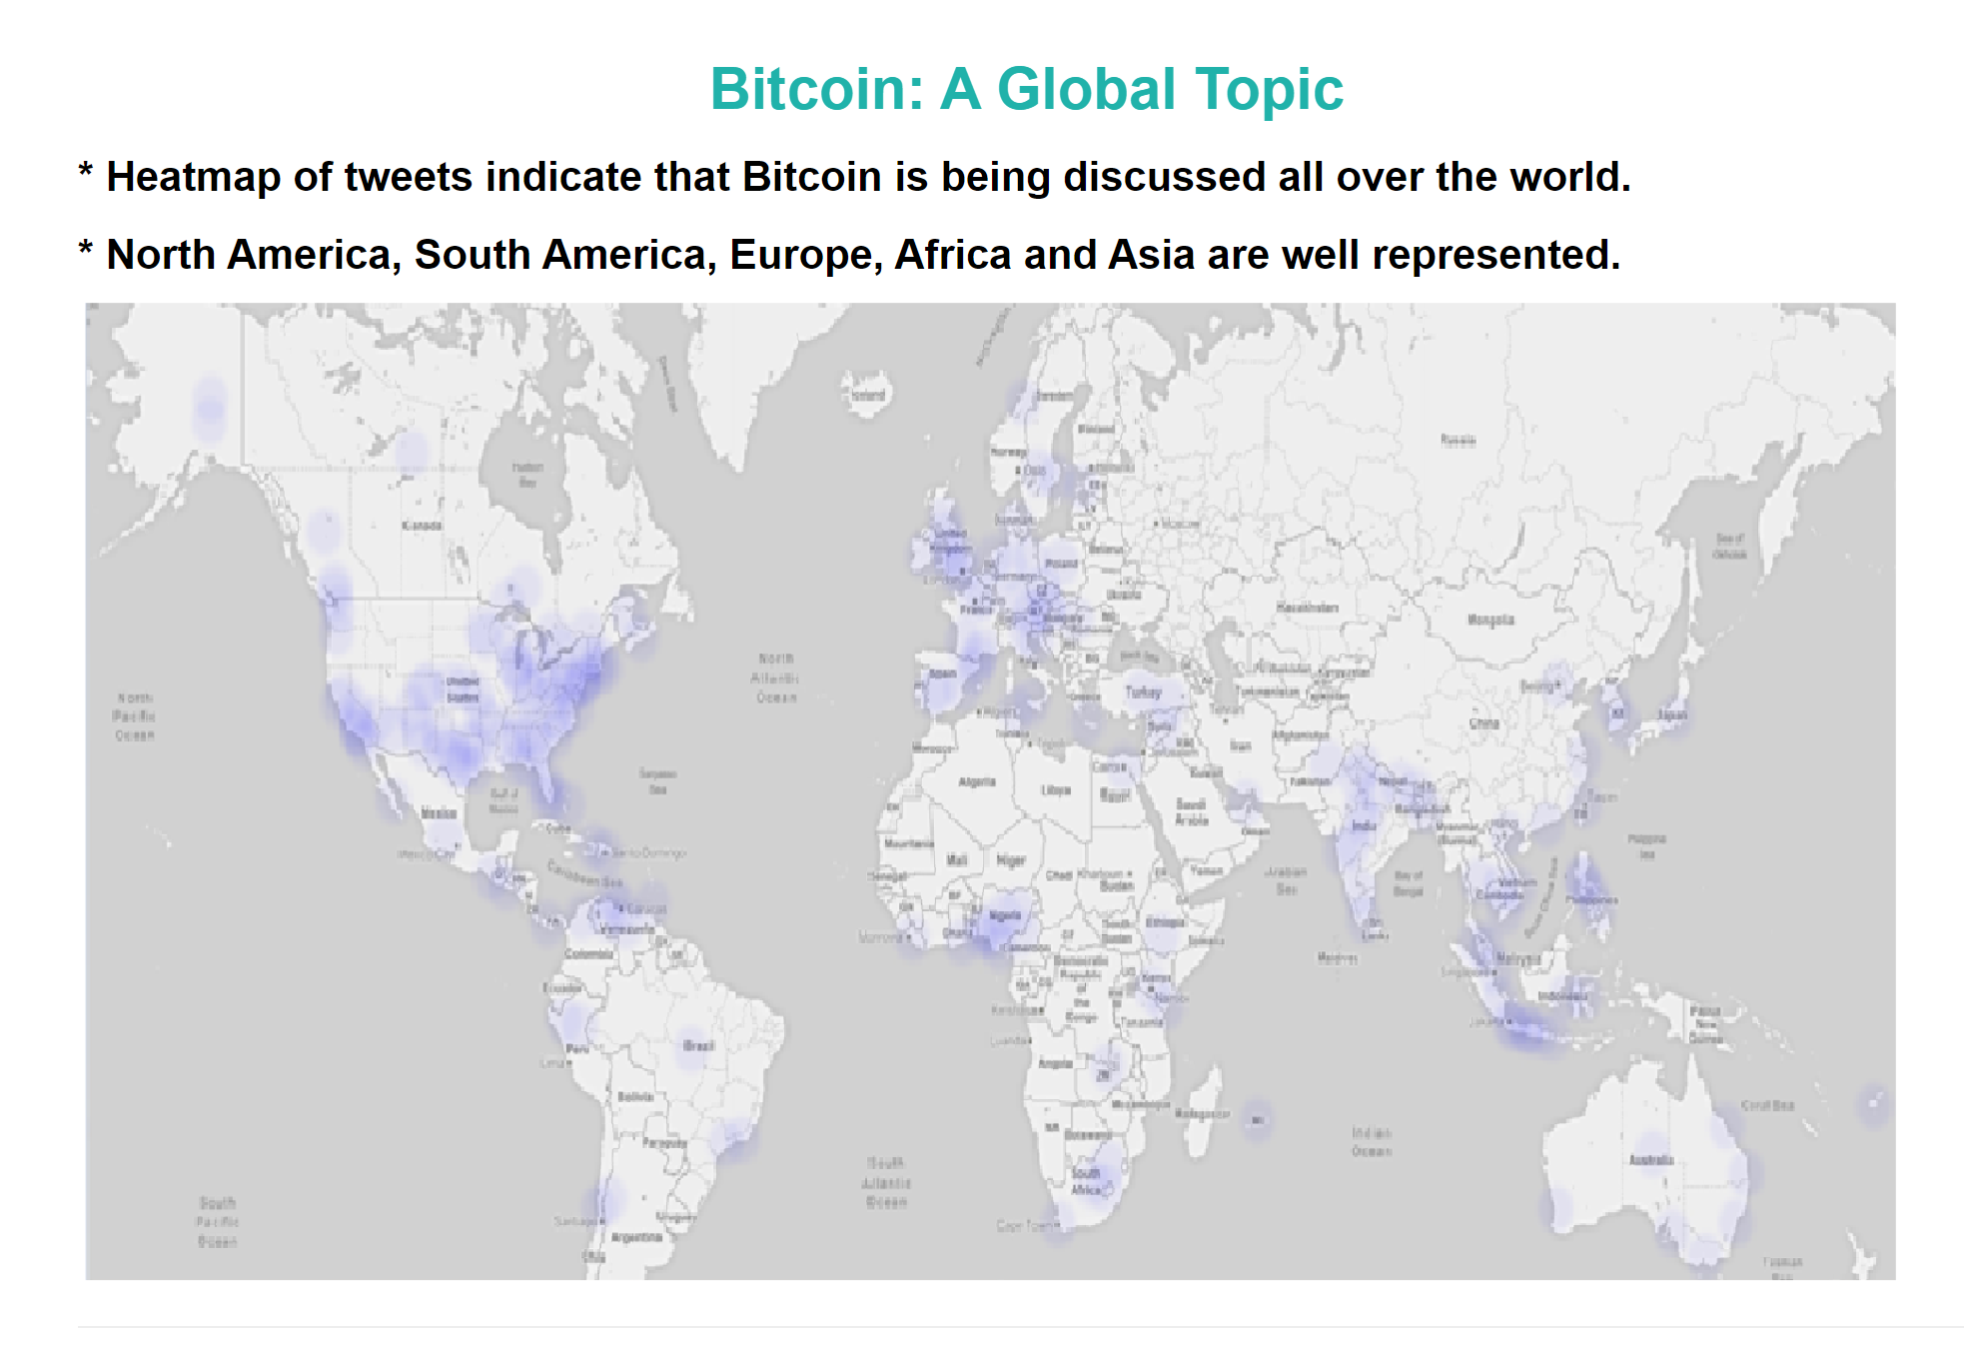
Can we use tweeter to identify sentiment movements which could lead us to act (research more, sell or buy)? First -> we listened twitter for a couple of hours, and we got a good representation of global tweets. Jing will explain to you want we found about sentiment.

Slide 4
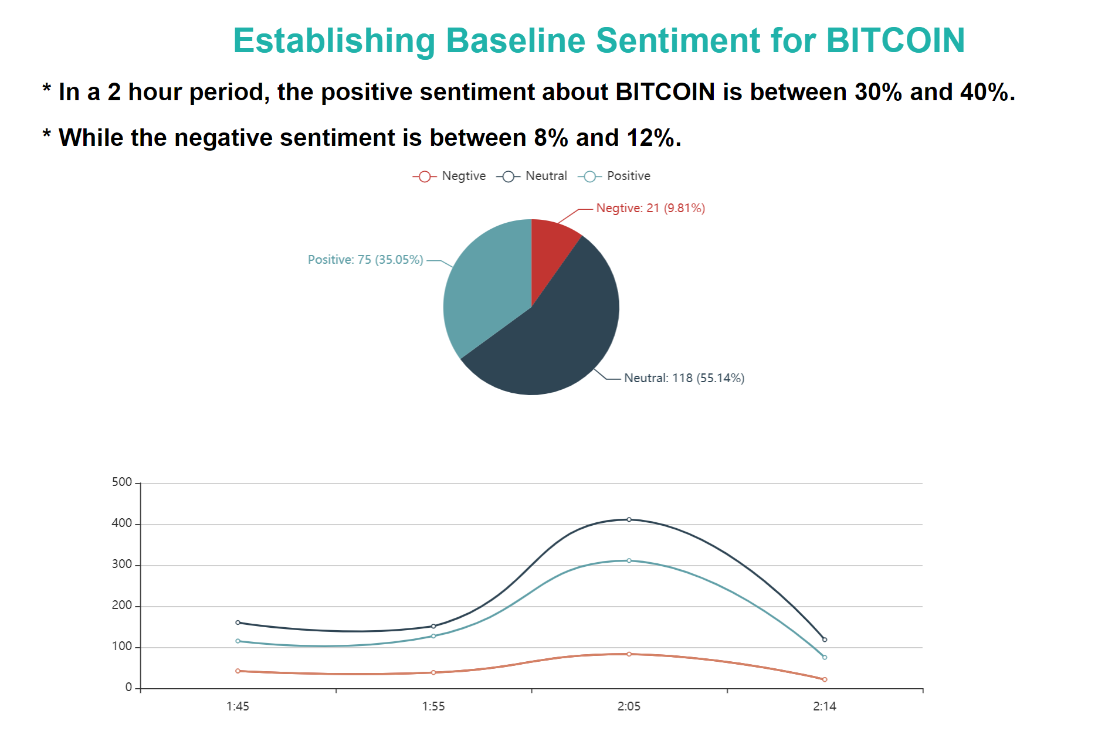

Slide 5
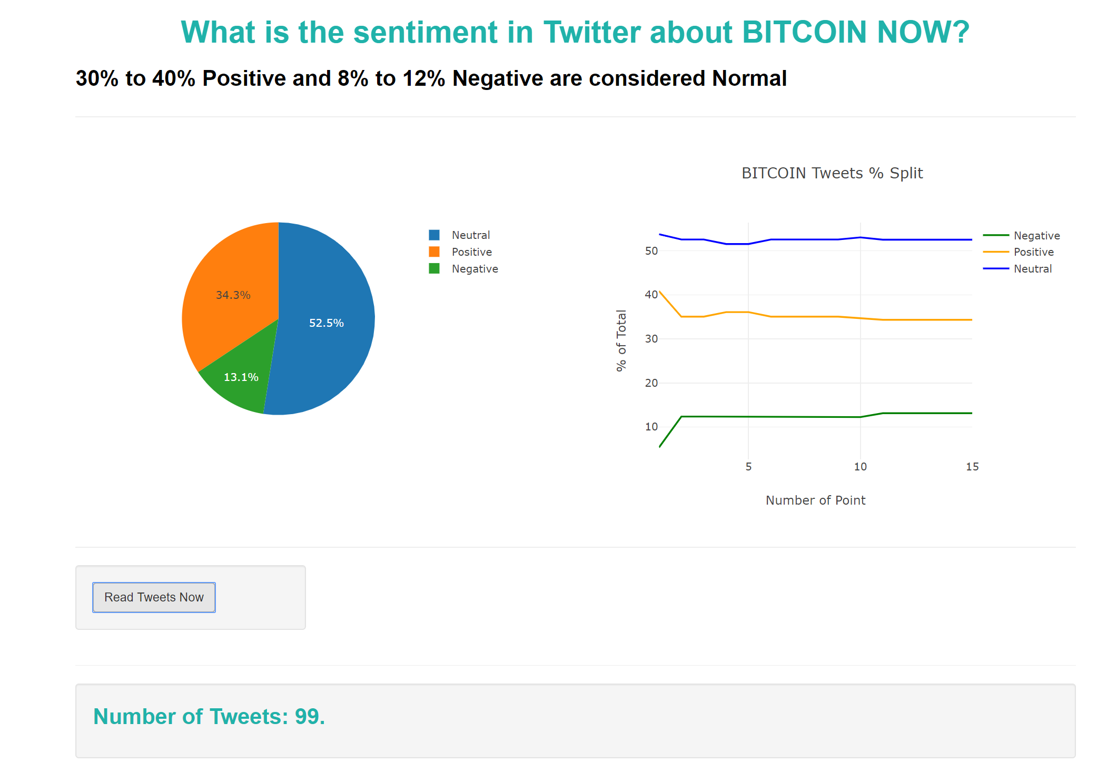

Slide 6
